Slide 1
AP sigma environment setup SOP

Slide 2
Outline
Introduction
Device preparation
Network route configuration
Environment setup steps

Slide 3
Introduction
This SOP is designed for AP sigma testing, including following programs:
WMMPS
TGn
PMF
TGac
WPA2 security improvement

Slide 4
Device preparation
One notebook(CA notebook)
With Windows OS and connect with UCC and the test device
One test device(APUT)
Connecting to the notebook with USB cable

Slide 5
Network route configuration
Data network switch
(192.165.x.x)
Control network switch
(192.168.x.x)
CA
eth0
UCC
192.165.100.162
192.168.250.99
eth1
bridge
rndis
usb cable
APUT
rndis
Testbed APs
Control network
192.165.100.99
Data network
bridge
Testbed STAs
USB cable
Wireless network
ap0

Slide 6

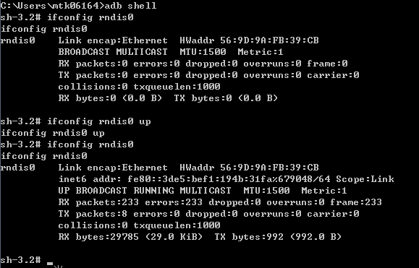
Environment setup steps (1/4)
Prepare one yocto board as DUT (APUT) , and one notebook as control agent notebook (CA). Connect APUT to CA notebook with USB cable.
Fixed Wi-Fi mac address on APUT and also update the Mac address in init file
Use Ethernet cables to connect CA notebook to control network switch (192.168.x.x) & data network switch (192.165.x.x) separately
Confirm the DUT has rndis0 interface and use cmd to up the rndis0 intercace just like the following

Slide 7
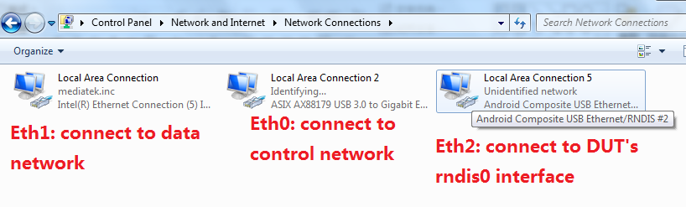
Environment setup steps (2/4)
5. Confirm the CA netbook will has 3 Ethernet interface (Eth0 ~Eth2)

Slide 8
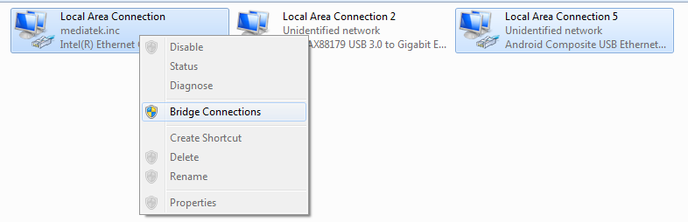
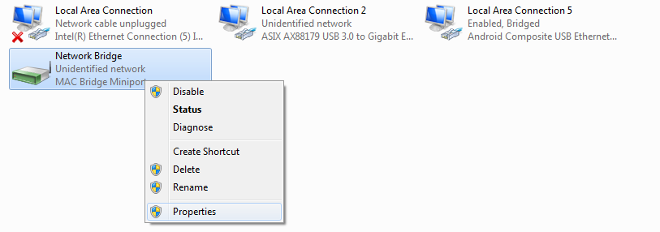
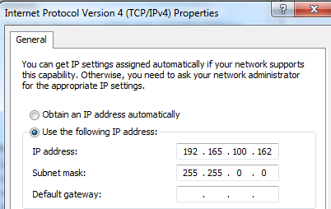
Environment setup steps (2/4)
Create a bridge between data network and USB network on CA notebook and set a available IP & net mask for this bridge network, eg. IP: 192.165.100.162, netmask: 255.255.0.0

Slide 9
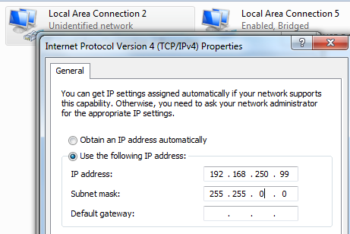
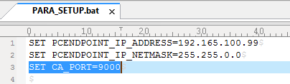
Environment setup steps (3/4)
Setup control network, eg. IP: 192.168.250.99, netmask: 255.255.255.0
Set IP address of control network (192.168.x.x) on CA notebook for Eth0.
Update init file
Update PARA_SETUP.bat in AP sigma tool to modify CA_PORT to 9000
## PC Endpoint (WFA Traffic generator console)

Slide 10



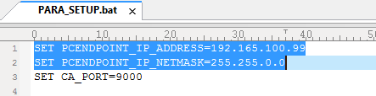
Environment setup steps (4/4)
Setup APUT’s wireless network, eg. IP: 192.165.100.99, netmask: 255.255.0.0
Update init file
Update PARA_SETUP.bat in AP sigma tool to modify PCENDPOINT’s ip address
## PC Endpoint (WFA Traffic generator console)

Slide 11

Install & run sigma tool
Click the following script by sequence

